Slide 1
Dynamic Programming

Slide 2
Definition
Dynamic programming is an optimization of current recursion solutions by maintaining a data set. There are mainly two patterns of storing data:
Tabulation
Memoization
If we start our transition from our base state i.e dp[0] and follow our state transition relation to reach our destination state dp[n], we call it Bottom Up approach of DP
If we need to find the value for some state say dp[n] and instead of starting from the base state that i.e dp[0] we ask our answer from the states that can reach the destination state dp[n] following the state transition relation, then it is the top-down fashion of DP.

Slide 3
Tabulation - Bottom Up
int dp[maxN]; int dp[0] = 1; for(int i=1; i<=n ; i++) { dp[i]=dp[i-1] * i ; }
The above code clearly follows the bottom-up approach as it starts its transition from the bottom-most base case dp[0] and reaches its destination state dp[n]. Here, we may notice that the dp table is being populated sequentially and we are directly accessing the calculated states from the table itself and hence, we call it tabulation method.

Slide 4
Memoization – Top Down
int dp[MAXN] int solve(int x) { if (x==0) return 1; if (dp[x]!=-1) return dp[x]; return (dp[x] = x * solve(x-1)); }
As we can see we are storing the most recent cache up to a limit so that if next time we got a call from the same state we simply return it from the memory. So, this is why we call it memoization as we are storing the most recent state values.

Slide 5
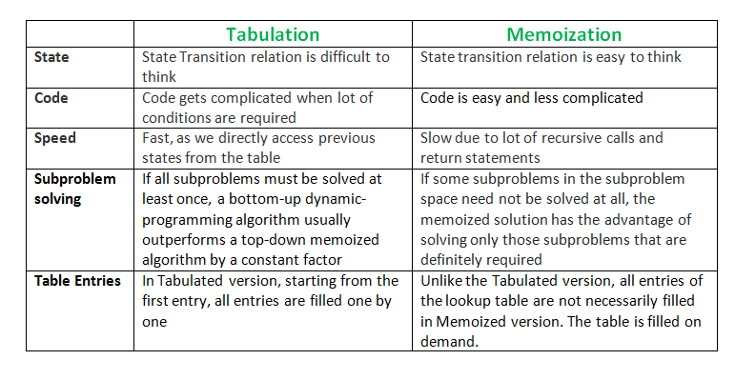

Slide 6
Problem Statement
Ugly numbers are numbers whose only prime factors are 2, 3 or 5. The sequence 1, 2, 3, 4, 5, 6, 8, 9, 10, 12, 15, … shows the first 11 ugly numbers. By convention, 1 is included.
Given a number 150, the task is to find 150th Ugly number.
Answer to this is implemented in “Ugly_Numbers.py”

